Slide 1
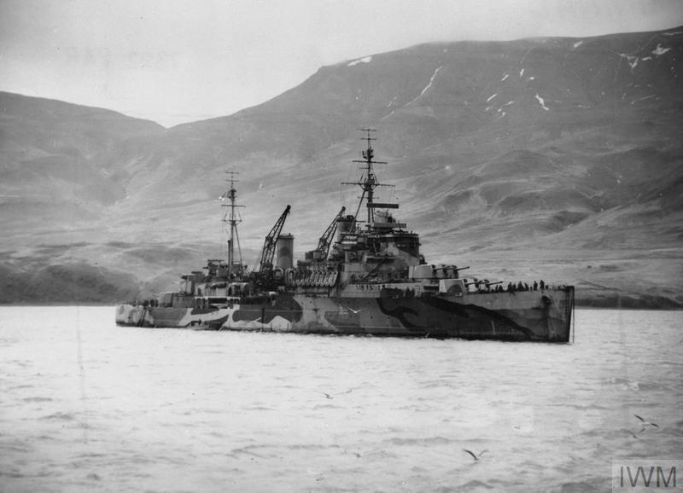
British Large Light Cruisers:
The Town, Fiji & Minotaur classes in action
1939 – ’45

Slide 2
Overview
In the 1930s & early ‘40s Britain constructed a significant number of large, light cruiser type vessels. The characteristics of these ships were determined by their global trade defence role, treaty obligations (London Naval Treaty[ies]) & the features of vessels built by rival navies, particularly the United States & Japan, while their size, especially the 10 Town-class, rivalled earlier heavy cruiser types due to an oversight in treaty terms.
As the most modern large cruisers available to the Royal Navy, the Town & Fiji classes provided the backbone of the RN cruiser force during the Second World War, frequently operating alone, alongside their predecessors, smaller types, battleships or battle-groups in all major theatres of the conflict. Three of the follow-on Minotaur (Swiftsure) class were also completed by the end of the war, with Swiftsure seeing action in the Pacific campaigns
Although intended for surface combat, engagements with opposing vessels were comparatively rare: however, the types participated in several such dramatic battles, & were in constant workhorse operations including convoy escort, providing AA cover and shore bombardment. Although less glamourous, these operations were critical to the establishing and maintenance of the sea control that helped win the conflict, & saw six of their number lost in action. This talk provides an overview of their characteristics & examples of their operations during the conflict.

Slide 3
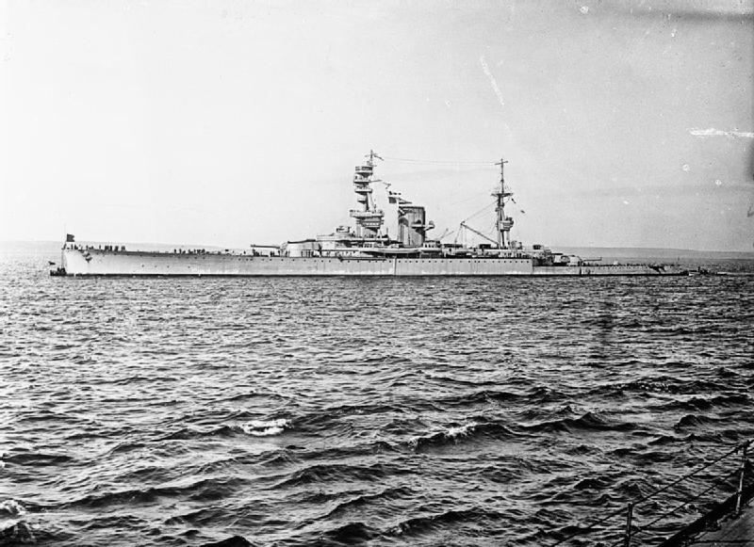
What we are not discussing:
Light battlecruiser [‘large light cruiser’] HMS Courageous
Designed for Admiral Sir John Fisher’s Baltic landing strategy, 1917
Term used as cover to get funding authorisation due to Chancellor forbidding construction of capital ships in 1915

Slide 4
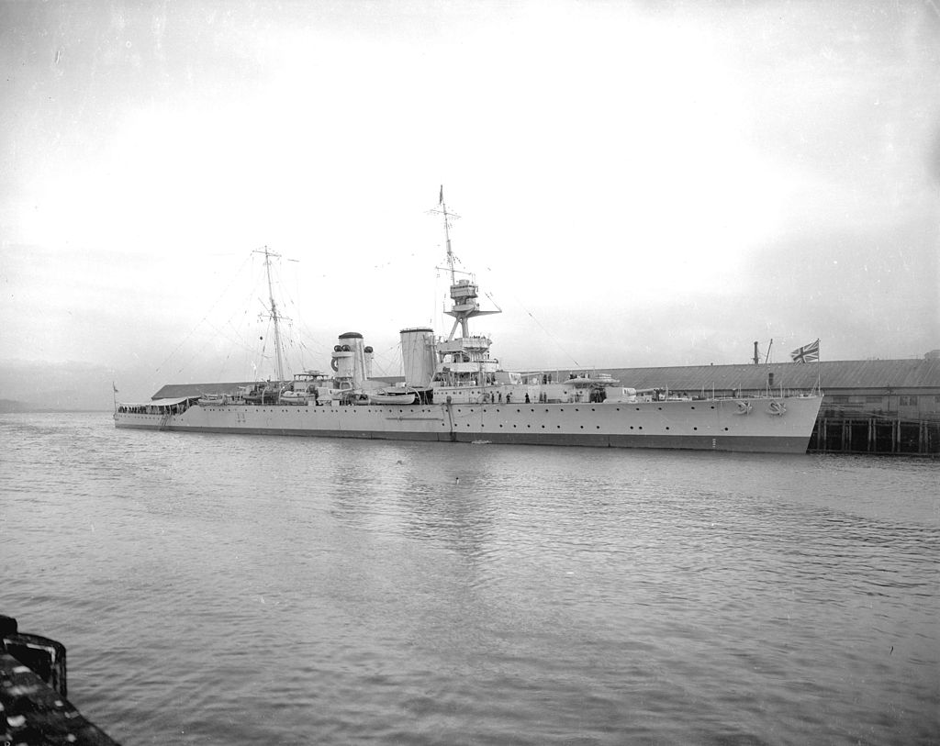
Origins:
Hawkins class:
HMS Raleigh of Hawkins (Elizabethan) class.
First ‘modern’ heavy cruisers, designed 1914-’15
Also classed as ‘large light cruisers’ during development –more practical general purpose vessels than Courageous class light battlecruisers & set pattern for future heavy cruisers with 7.5in + main artillery

Slide 5
Washington Naval Treaty stipulations:
Washington Treaty (1922)
No limitations on total tonnage or numbers of cruisers due to differing requirements of participants
Qualitative restriction set: 10,000 tons max. displacement & 8in maximum main artillery
Critical error made from British perspective. Set tone with Hawkins class (& regretted due to cost). Inevitable result: with capital ship construction under 10 year hiatus, naval powers simply built cruisers up to the maximum limits
Unaffordable for RN (long term unaffordable for everybody) which needed large numbers of cruisers (70 mooted) due to global maritime empire

Slide 6
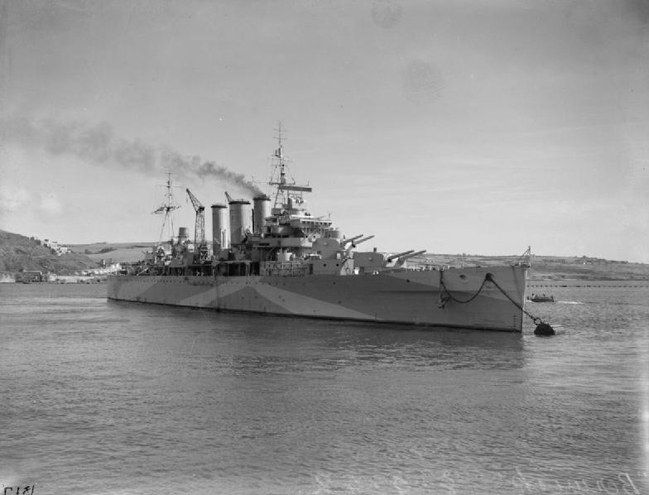
County-class
‘Treaty cruisers’
HMS Berwick
County-class ‘A’ cruiser
8in gunned 10,000 ton treaty [retrospectively ‘heavy’] cruiser. Successor to Hawkins-class
13 constructed, limitations in armour but reasonably balanced within displacement limit
Too costly to continue construction, esp. in light of economic conditions

Slide 7
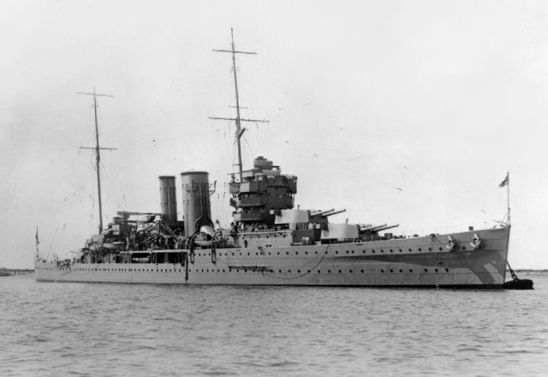
York-class
HMS York
York-class ‘B’ cruiser
Reduced 8in gunned treaty / ‘heavy’ cruiser, 1927
Designed under 1922 Washington Treaty stipulations
Cut-down 8,500 ton County class with 6 x 8in
Cost savings insufficient to justify further construction

Slide 8
London Naval Treaty (1930)
Successor to Washington Naval treaty
Distinguished between ‘light’ cruisers (cruisers armed with artillery up to 6.1in) and ‘heavy’ cruisers (cruisers armed with artillery up to 8in)
Number of heavy cruisers limited per nation
No restriction on numbers of light cruisers but total tonnage per nation limited
Note anomaly: no maximum displacement set for light cruisers other than blanket 10,000 tons
Inevitable result: treaty signatories build large light cruisers up to 10,000 ton limit, or to describe another way: heavy cruisers with a large battery of lighter weapons.

Slide 9
Town Class:
overview
10 vessel class of large light cruisers: built in three groups –Southampton & modified Gloucester sub-class, with final two significantly enlarged Edinburgh class vessels.
Designed primarily for trade protection & engaging surface vessels: large battery of rapid-firing 6in main armament; torpedo provision less significant. Provision for catapult and two Supermarine Walrus amphibians + hanger space key aspects of design
Within displacement restrictions, protection partly sacrificed to offensive load, range & seakeeping / practical sea-speed. Protective scheme varies between classes; broadly intended to defend against 6in fire at all probable battle ranges. More limited against aerial attack or long-range plunging fire; borderline adequacy in earliest vessels, superior in larger Edinburgh class (for given requirements, a large ship likely to have fewer compromises / more room for growth)
Issue in both types with armour & forecastle deck configuration latter having break as armour stepped down leading to structural stresses in hull & requiring modification

Slide 10
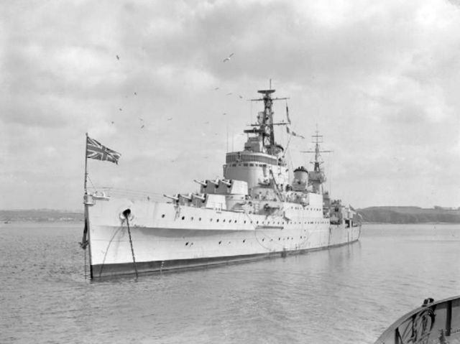
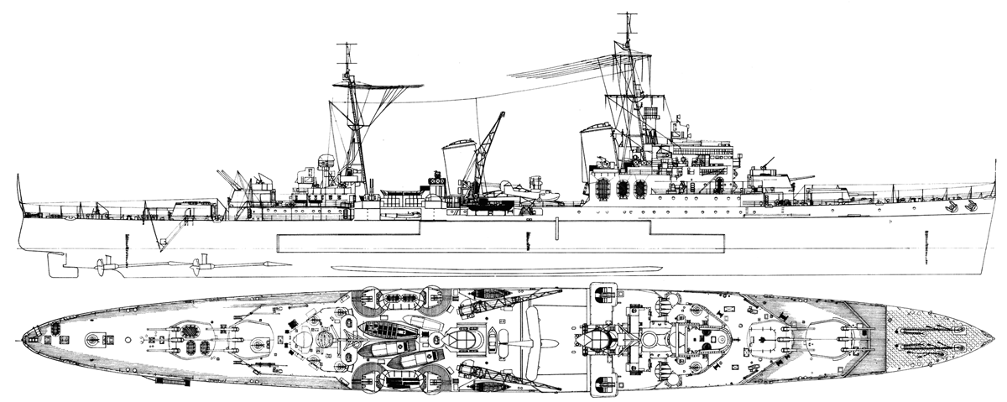
Southampton & Gloucester [sub]classes
Designed to nominal 9,100 ton mark (reduced cost)
591ft 6in x 61ft 8in (62ft 4in Gloucester)
32 – 32.25 knots (trials)
12 x 6in in 4 x triple turrets, 8 x 4in QF in 8 x twin, pr triple 21in torpedo tubes
4 1/2in cemented belt & magazine boxes, 2 1/2in bulkheads, 1in turrets (Gloucesters 2in – 4in), 1in - 2in trunkings, 1in – 2 1/2in decks
2 x Supermarine Walrus

Slide 11
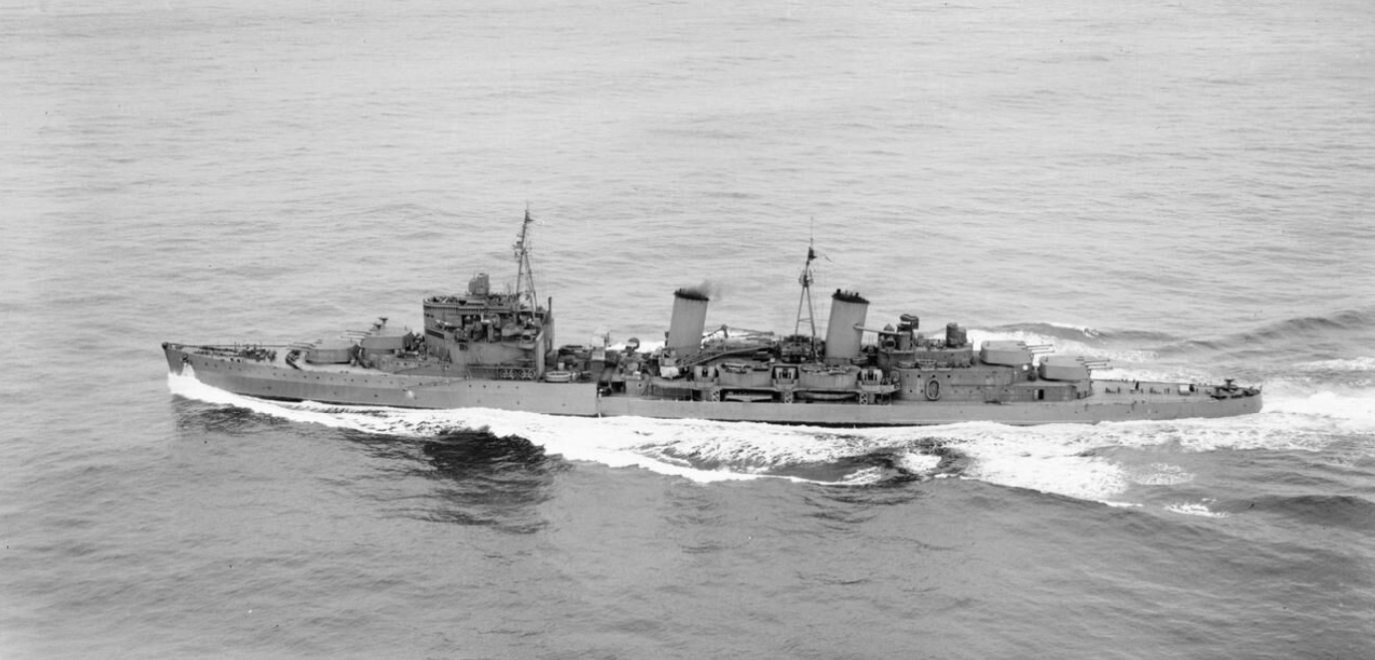
Edinburgh-class
Final two Towns heavily revised & significantly enlarged
10,550 tons standard, 613ft 6in x 63ft 4in, 32.25 – 32.5 knots [trials]
12 x 6in in 4 triple turrets (16 x 6in in 4 x quadruple turrets considered), 12 x 4in in 6 x twin. 2 x triple 21in torpedo tubes
Belt 4 1/2in cemented, extended relative to previous classes to cover magazines & do away with internal box. Bulkheads 2 1/2in, turrets 2in – 4in, trunkings / ring bulkheads 1in – 2in, decks 1 1/2in – 3in
3 x Supermarine Walrus

Slide 12
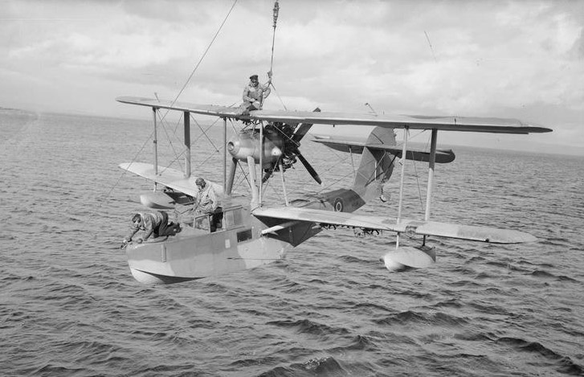
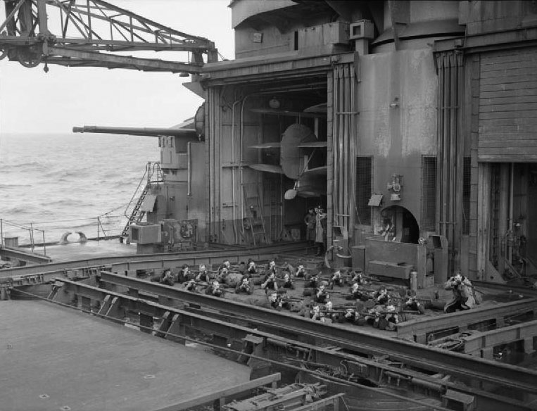
Supermarine Walrus
Maritime patrol amphibian

Slide 13
Fiji class
Town-class reduced per stipulations of 2nd London Naval Treaty for maximum size of light cruiser to nominal 8,000 tons.
Built several batches. 8 x original Fiji design, 3 x modified Ceylon type
555ft 6in o/a x 62ft. Transom stern. 8,670 tons standard, 10,620 tons full load [nominals], 31.25 – 31.5 knots [trials]
1st batch 12 x 6in in 4 x triple turrets; 8 x 4in QF in 4 x twin, 2 x triple 21in torpedo tubes
2nd batch [Ceylon grp] reduced 9 x 6in in 3 x triple turrets
3 1/4in – 3 1/2in belt [non-cemented], 1 1/2in – 2in bulkheads, turrets 1in – 2in, ring bulkheads 1in, deck 1 1/4in – 2in
2 x Supermarine Walrus

Slide 14
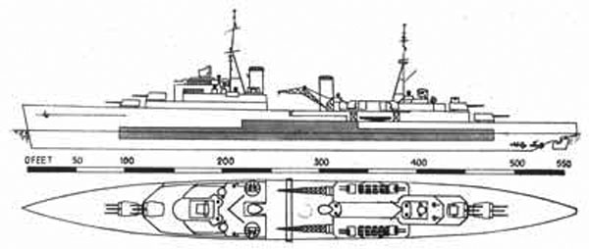
Sketch plan Fiji class showing belt armour

Slide 15
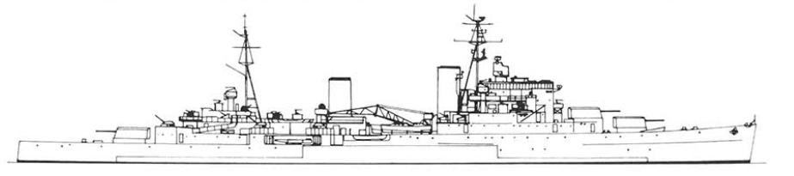
Minotaur [Swiftsure] class
Swiftsure / Minotaur class modified versions of Ceylon batch Fijis ‘incorporating war modifications’ [authorised 1941]
9 – 12 planned, 3 completed by end WW2 [Minotaur, Swiftsure, Superb]. Others cancelled or reordered as post-war Tiger-class.
Saw little action as completion low priority; Swiftsure flag British Pacific Cruiser Squadron; Cecil Harcourt selected to hoist flag Japanese surrender Hong Kong
8,800 tons standard; 555ft 6in o/a x 63ft [64ft Superb], 31.5 knots [trials]
9 x 6in in 3 x triple turrets, 10 x 4in QF in dual mounts, 2 x triple 21in torpedo tubes
Notes:
IWM (A 30539)

Slide 16
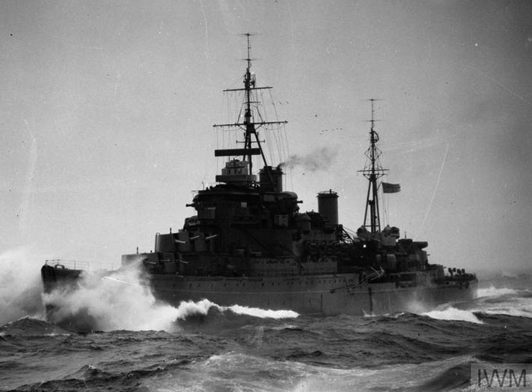
The Arctic
Town & Fiji classes employed extensively in northern waters –convoy protection in both directions (typically to / from Murmansk), cover for minelaying or minesweeping operations or blockade-breaker patrols in esp. GIUK gap
Both types see losses & participate in well-known convoys & operations inc. Battle of North Cape, covering potential sorties by Tirpitz or other major vessels, and providing cover / escorts for carriers in ariel operations against ‘Lonely Queen of the North’ e.g. Operations Tungsten and Mascot
Northern operations not glamourous but of major importance. Both types basically well-suited to task: wet but good sea boats due to size, decent range, well-armed (esp. effective AA), with effective radar & with reasonable tactical diameter [i.e. relatively agile for dimensions] so balance with smaller types, carriers or heavier units well
HMS Kenya north of Arctic Circle

Slide 17
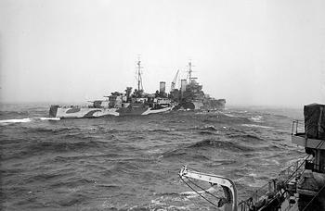
The Ship that Torpedoed Herself
HMS Trinidad (Batch I Fiji) attached to Home Fleet 10CS. Spends much of career in northern waters.
Escorted outbound PQ8 & returning PQ6
Deployed February ‘42 barrier patrols GIUK Gap; supported (cover) minelaying operation in Northern Barrage.
Early March dispatched Scapa assist refuel Home Fleet destroyer screen (supporting PQ 12 & countering abortive Tirpitz sortie)
21 March departs Scapa for Seidisfjord; escort for outbound PQ 13 (19 vessels). Poor weather results in convoy spread out over 140 nm distance; noted by German aerial reconnaissance & destroyer flotilla Z24 – Z26 dispatched intercept
0700 29 March Trinidad searching destroyers & sweeping ahead convoy visual & radar.
0815 enters snow squall; 0843 radar contact 6 ½ miles, pinpoints by 0847 with visual contact shortly afterward.
0851 opens fire on Z26 at 2nm; 5 radar controlled broadsides hitting from 2nd salvo with effect. 1min later shifts fire to Z25; 3 broadsides with additional 4in QF. Hit by 2 x 15cm.
Manoeuvres hard starboard to avoid torpedo spread launch; contact briefly lost
HMS Trinidad refuelling, in Arctic dazzle paint scheme

Slide 18
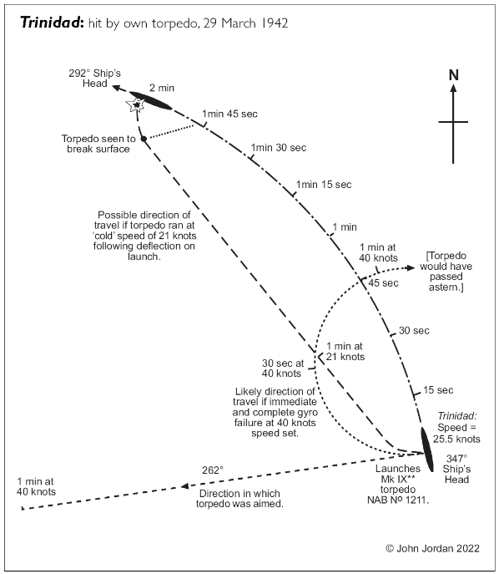
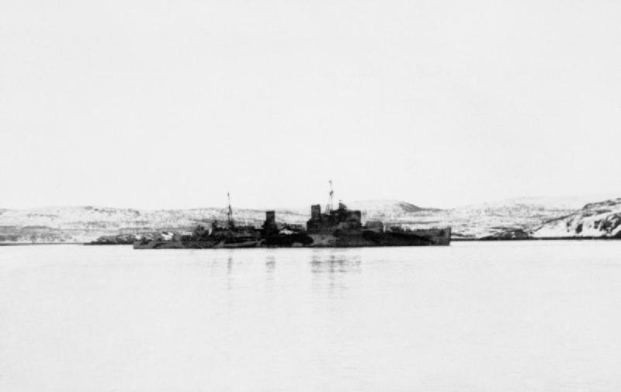
Arctic cold
Contact regained 0857; 0917 Trinidad fires some 24 salvos forward turrets, 13 X & 10 Y turrets approx. 2,900yds. Z26 fine on port bow
Approx. 0920 torpedo office attempts fire 3 port tubes. 2 x malfunction. One launches. 0923 torpedo spotted port side; explodes slightly forward A boiler room. 45ft x 20ft hole blown in side, flooding boiler room & adjacent compartments; 17 degree list. Torn hole 10ft x 7ft on opposite side; major fires lower deck
Divided ring mains allows power maintained. Able to make 6 – 8kts; counter-flooding reduces list & 14kts achieved.
Makes entrance Kola Inlet 0930 30 March. Entered graving dock Murmansk 7 April.
Appears cold affected above-water tubes & torpedoes. Single fired torpedo running slower than should; likely diverted course due to failure caused by lack cold-weather oils

Slide 19
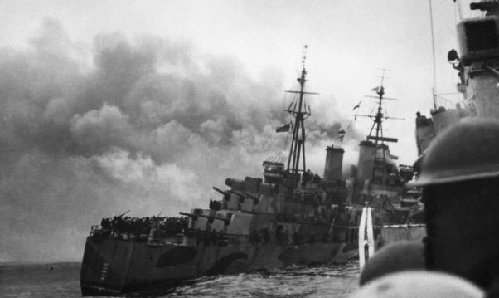
Loss HMS Trinidad
Trinidad patched up mid-May for return journey; helped by arrival consignment steel plates on Edinburgh (also lost on own return journey). Leaves dock 2 May, ran trials in mouth Kola Inlet. Restricted 22kts due to loss A boiler room
Weighed 2300hrs 13 May under flag of R. Ad. S. Bonham-Carter [having survived loss Edinburgh] with destroyer escort Somali, Matchless, Foresight & Forester. Russians promise air cover 1st 200 miles voyage; didn’t emerge. Spotted & shadowed Ju88s from morning 14th & force shadowed
2100hrs radar detects incoming aircraft. 25 dive-bombing attacks from Ju88s 2155, initially on destroyers.
2237 8 x torpedo bombers in 2 divided grps attack off both quarters; 2245 dive-bombing attack with 2 hits: starboard of bridge & blowing 20ft x 30ft hole to lower deck; flooding B magazine from 2nd hit & damaging temporary patch. Electrical & pump failures; major fire spreading & increased by cruiser’s speed as attempts avoid ‘half-hearted’ torpedo attacks. 2315 engines stopped to try to control blaze; midnight fire out of control. Skinner of DNC dept. ‘It would take the Glasgow fire brigade to put the fire out’. Trinidad abandoned; dispatched 3 x torpedoes from Matchless

Slide 20
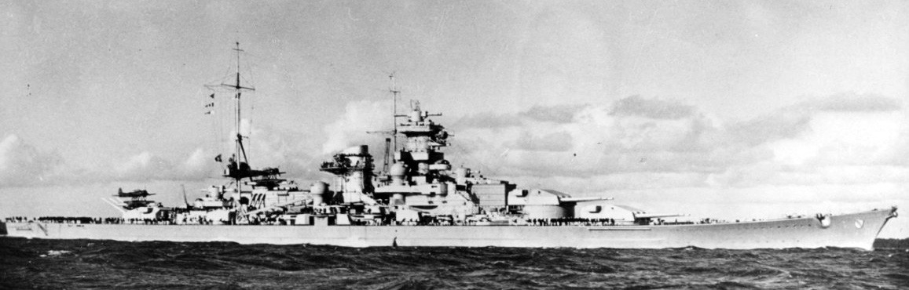
The Battle of the North Cape
26 December 1943
Attempted attack by German 2nd class battleship Scharnhorst (Rear Ad. Erich Bey) in operation Ostfront to attack Allied arctic convoys.
Outward bound 19-vessel JW 55B: close escort destroyers + smaller craft, ocean escort 8 HF destroyers.
Returning 22-vessel RA 55A from Murmansk: close escort destroyers + smaller craft, ocean escort 6 HF destroyers. Additional support Force 1 cruiser squadron: Town class Belfast (Flag Vice Ad. Robert Burnett) & Sheffield with County class heavy cruiser Norfolk
C-in-C Home Fleet (Adm. Sir Bruce Frazer) intending use JW 55B bait to draw out Scharnhorst with planned intercept between convoy route & Norwegian base

Slide 21
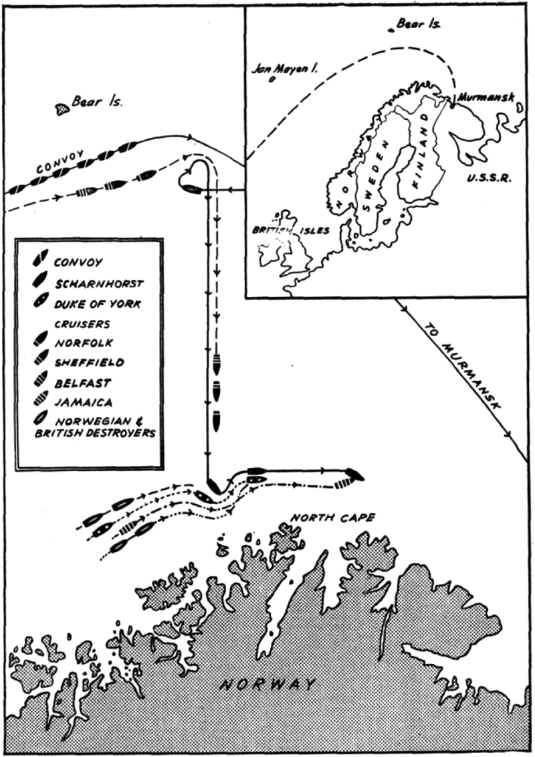
Initial stages
JW 55B departs Loch Ewe 20 Dec.
Spotted & shadowed Luftwaffe 22 & confirmed Allied forces following day
Frazer sails Force 2 Duke of York (flag) Fiji-class Jamaica 3 x S-class destroyers & Stord maintaining distant cover to avoid risk of German vessel abandoning operation
23 Dec. JW 55B ~250miles north Norway; slow pace.
Force 1 sails from Murmansk in east, Force 2 lurking to west
Scharnhorst sails 25 Dec. Altafjord with 5 destroyers in developing SW gale. Unaware of Forces 1 & 2 converging
26 Dec. Frazer informed Scharnhorst at sea: latter searching for convoy.
Weather atrocious, U-boat spots convoy; battleship unable to locate. Aircraft grounded, destroyers detached south to search: unable to regain contact with flag

Slide 22
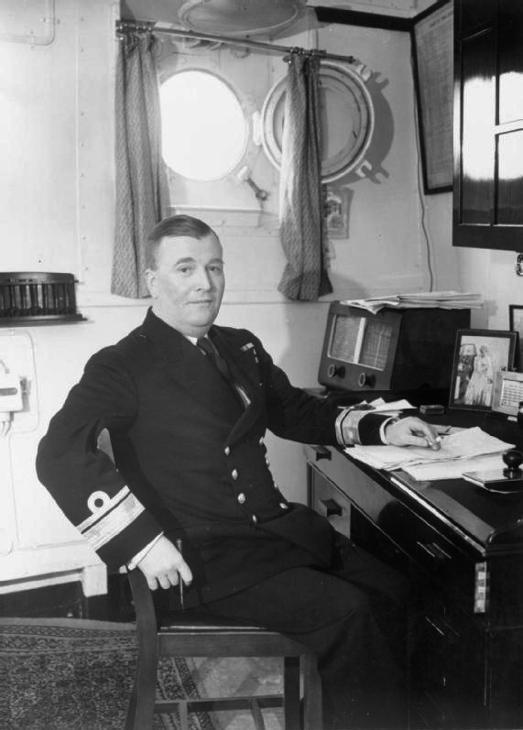
First Contact
Frazer diverts RA 55A north to clear. RA 55B ordered reverse course with 4 destroyers from former to join his force
Scharnhorst encounters Force 1 approx. 09:01.
Belfast locates on radar. Closes 13,000yds & cruisers open fire with 6in & 8in artillery, scoring 2 hits, destroying forward radar / radar controls. Mounting snowstorm & visibility worsening. German gunners reliant on optical ranging on muzzle flashes but British cruisers using new flashless propellant
Bey (likely) believed encountered battleship & attempted clear south to draw cruisers away from assumed convoy (?) Scharnhorst mediocre seaboat but larger & faster than cruisers.
Burnett declines to follow –cruisers limited to 24kts by conditions & engine trouble (Belfast significantly quicker); turns NE guessing Bey would attempt to circle around & attack convoy.
Admiral Burnett
In cabin aboard HMS Belfast

Slide 23
Contact re-established
Radar contact with German vessel regained slightly after 12:00 –risky but sound tactical thinking by Burnett
Scharnhorst, encountering Force 1 scores 2 hits Norfolk. Decides RTB, ordering destroyers to attempt attack convoy.
German battleship tries to clear south, Belfast pursuing & maintaining radar contact. Norfolk & Sheffield unable to maintain pace with engine issues leaving flag as sole pursuing vessel. Bey heading directly toward Force 2 intercept.
Note: enlarged Edinburgh sub-class with good freeboard for length / displacement makes effective [if wet] seaboat, helping maintain speed in conditions
16:15 Force 2 radar contact German vessel; 16:17 detected by Duke of York. Range approx. 45,000yds
16:32 closed 29,700yds
16:48 Belfast fires starshells

Slide 24
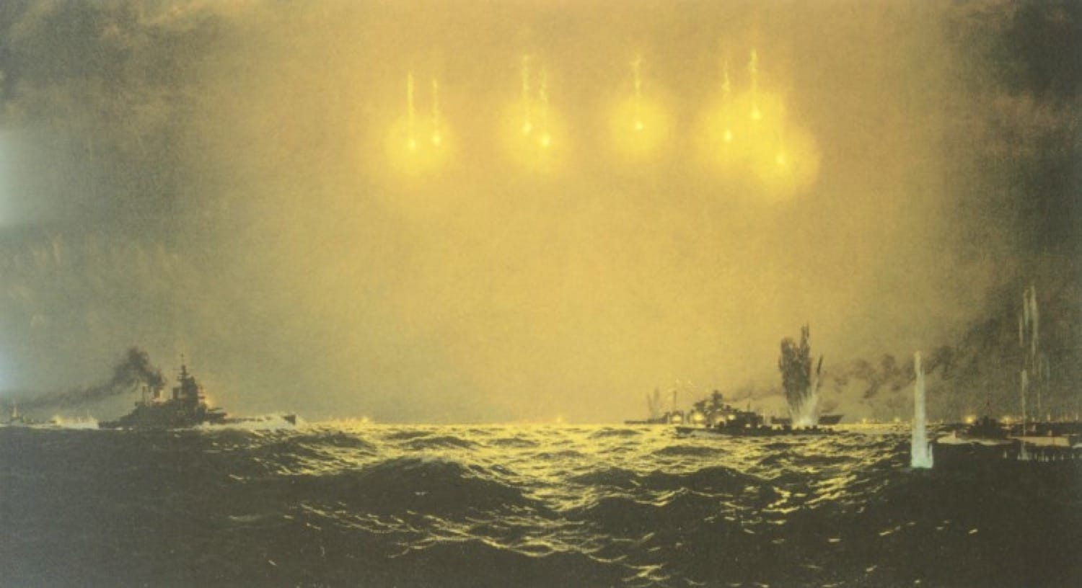
Scharnhorst illuminated star-shells from HMS Belfast

Slide 25
Contact, heavy units
Scharnhorst unprepared for action, turrets trained fore-aft. Battle running N-S, then W-E engagement
Duke of York opens fire range 11,920yds scoring 2 hits, disabling hanger & A + B turrets (B later brought back into action)
Scharnhorst turns north: re-engaged by 6in & 8in fire from Force 1 Belfast & Norfolk cruisers. German battleship caught between the two forces. DofY scores multiple 14in hits while escorting Fiji class Jamaica also engages with 6in with Force 1 engaging opposite side
Bey attempts using speed of vessel to clear east; 11in hit on DofY temporarily disables forward Type 284 radar ariel but quickly (remarkably in Force 8 gale) repaired
18:20hrs: 14in shell at long range pierces belt, destroys no.1 boiler room causing speed to drop. Dooms Scharnhorst; speed drops to 10knots –repairs allow 22knots but insufficient & allows destroyer torpedo attacks. Final message naval command ‘we will fight on until the last shell is fired’.
18:50 turns to engage pair S-class but opens self to attack from two more; 2-hits starboard side destroyers Scorpion & Stord

Slide 26
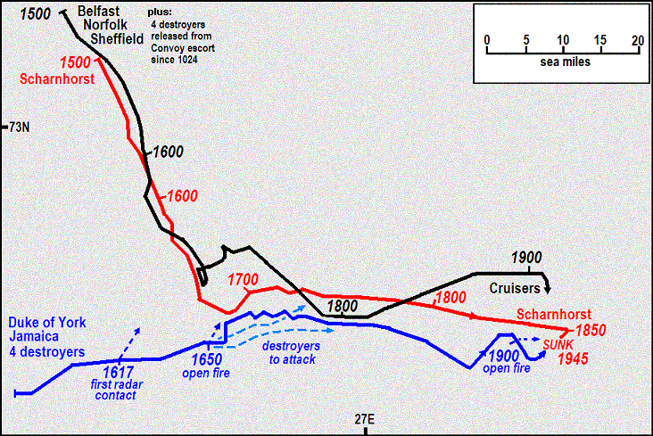
Battle of the North Cape:
Movements after Duke of York force engages

Slide 27
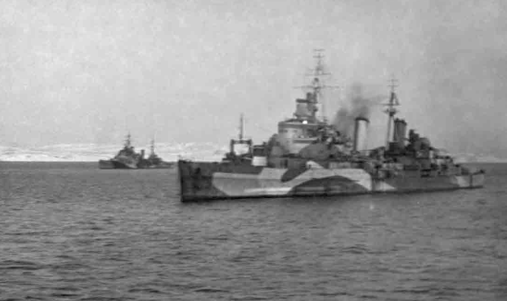
Destruction of Scharnhorst
Scharnhorst continues turn; hit by 3 torpedoes port side Savage & Samurez though scores hits on latter with secondary battery
Speed drops to 10knots, DofY closing range. Belfast illuminates star shells again; DofY, Jamaica re-engage 10,000yds. 19:15 Belfast also engages & with Jamaica fire remaining torpedoes
Opportune, Virago, Musketeer & Matchless fire further 19 torpedoes. Scharnhorst capsizes & sinks 19:45. 36 survivors from 1,968. British casualties officially 21 killed, 11 wounded
HMS Belfast (fore) & HMS Jamaica, taken from HMS Sheffield
Probable Kola Inlet after battle
(C. Waters)

Slide 28
The Mediterranean
Size & effect
Town class vessels initially employed in Mediterranean; however belief that class was ‘too large for fleet operations in relatively confined waters’ [see C. Waters] –view also held by C-in-C Cunningham: ‘I don’t like these Southampton class. They are fine ships but that great hanger structure seems to provide a good point of aim: they are always being hit there’.
Latter view partly open to question given subsequent record; would also apply to Fiji’s & types considered formidable AA vessels. Southampton & Gloucester both lost to air-attack 1941 however (Jan & May respectively) & type withdrawn from permanent assignment to theatre with focus for remaining vessels shifting to trade protection role originally intended for the class

Slide 29
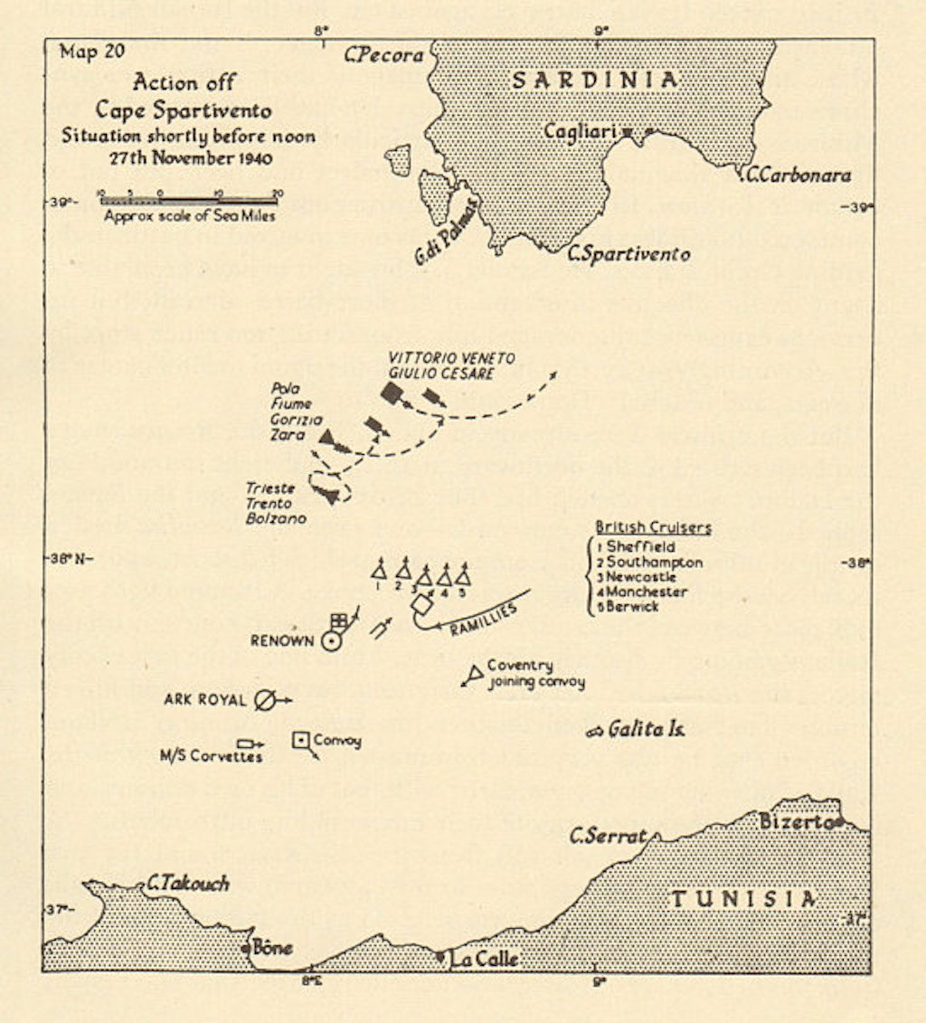
Battle of Cape Spartivento -opening
Action RN & Regia Marina 27 November 1940
17 November Italian battleships + consorts attempt intercept of carriers Ark Royal & Argus carrying aircraft to reinforce Malta defences. No direct contact but forces RN vessels RTB (Gibraltar) casting doubt on future support convoy Operation Collar. Latter attempted however with additional support from Force H & Force D.
Italian surface combatants more powerful but commander (Campioni) instructed to avoid combat unless odds heavily in favour so decisive battle unlikely
RN Force under Sommerville deployed two groups: 5 x cruisers under Lancelot Holland (that one) ahead with 2 x battleships + 7 destroyers behind. Ark Royal to south preparing launch Swordfish torpedo bombers. Battlecruiser Renown also lurking in offing Italian fleet in 3 grps, 2 of 6 heavy cruisers present + 7 destroyers; behind 2 x battleships + 7 more destroyers
12:07 Campioni receives report from floatplane indicating approx. equivalence in forces; ordered cruisers reform on battleships & prepare to clear; mis-times as lead cruisers already turned toward & engaging British forces.

Slide 30
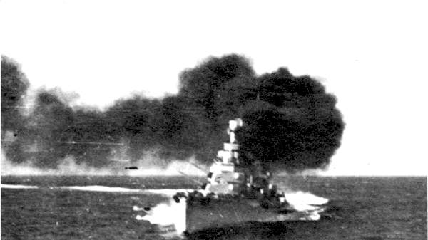
Battle of Cape Spartivento -engagement
12:22 lead units opposing cruiser forces inc. Sheffield, Manchester & Southampton in range & engaging; v. long initial range over 25,000yds & fire rapid. Italian vessels outgun British; battleship Ramillies comes up in support but not fast enough to maintain formation dropping back 12:26
Italian cruiser commander Iachino receives orders disengage 12:30; retires on smoke. HMS Manchester hits destroyer with 6in fire, disabling. County class HMS Berwick struck twice & damaged from 8in fire
12:40 Swordfish attack battleship Vittorio Vento without effect; HMS Renown engaging with 15in & closing cruisers until Vittorio Vento engaged at 30,000yds driving cruisers back on Renown
54 minute engagement without major result; 7 men killed, 9 wounded Berwick

Slide 31
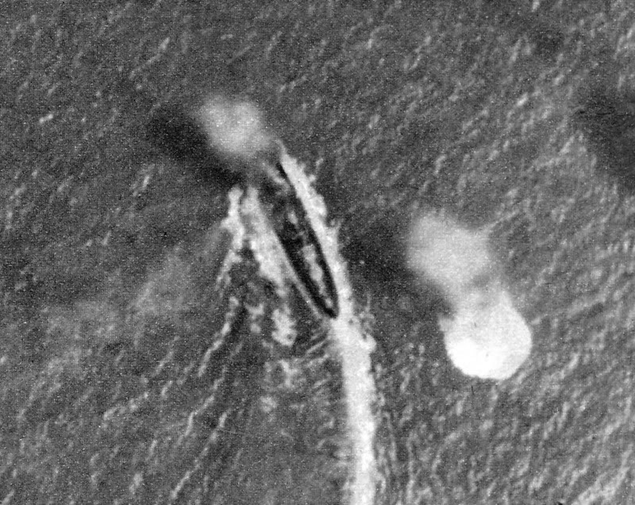
Loss of HMS Southampton
11 January 1941
Southampton with other units (inc. other Towns) participate Operation Excess –series supply convoys to Malta
11 January attacked with half-sister Gloucester by Ju87 dive bombers of Sturzkampfgeschwader 2 south Malta. British vessels not yet radar equipped & relaxed (3rd) degree readiness
Struck by 2 – 4 250kg bombs. 1 or 2 penetrating port hanger roof, exploding vicinity A boiler room. Other strike[s] in vicinity X gun deck forward of turret; upper deck forced upward whole width of ship in region of wardroom & holed for area of approx. 25ft.
Fire breaks out & fire main severed; approx. 27 officers killed outright limiting damage control. Initial prospects positive, but conflagration spread, progressively killing power.
81 killed, survivors taken off by Gloucester & destroyer HMS Diamond. Hulk sunk by torpedo from Gloucester & 4 additions from Leander class light cruiser HMS Orion

Slide 32
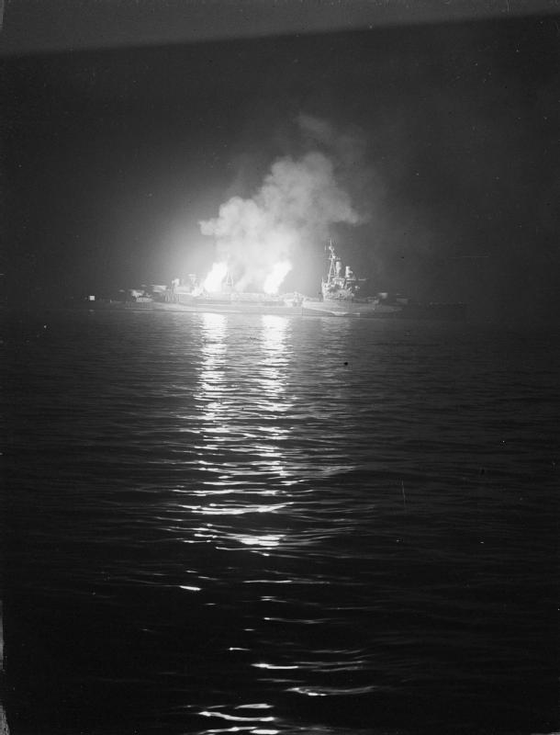
Operation Neptune –
Shore Bombardment
HMS Belfast headquarters ship Bombardment Group E supporting British & Canadian forces Gold & Juno beach sectors
Belfast departs Clyde 2 June ‘44. Churchill desired be aboard –prevented by King. 6 June ‘44, 0530 Belfast bombards German artillery battery at Ver-sur-Mer;
12 June supports Canadian troops as move inland from Juno beach; retires Portsmouth 16 June to replenish ammunition, returning 18 June. Supported Operation Charnwood (battle for Caen) 8 July with battleship HMS Rodney & monitor HMS Roberts before fighting moved out of 6in gun range. Over 5 weeks fired 1,996rds of 6in & over 2,500 4in
HMS Glasgow part bombardment support group C Omaha Beach. 25-26 June supported US forces Bombardment of Cherbourg shelling batteries new Querqueville; received damage from exchange fire

Slide 33
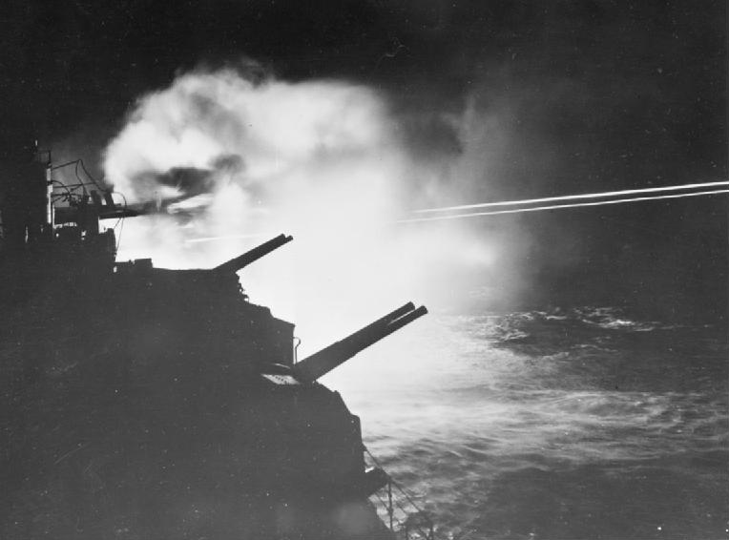
Neptune / Overlord-
Aftermath & support
HMS Mauritius (Fiji) assigned Force D cover landings Sword Beach. Already familiar in role as covered Salerno & Anzio landings over previous 12 months
Following landings, August ‘44 engaged in offensive patrols Brittany coast with escorting destroyers mop up remains enemy shipping
Participated Battle of Audierne Bay (see right) sinking 5 x flakships night action 22-23 August

Slide 34
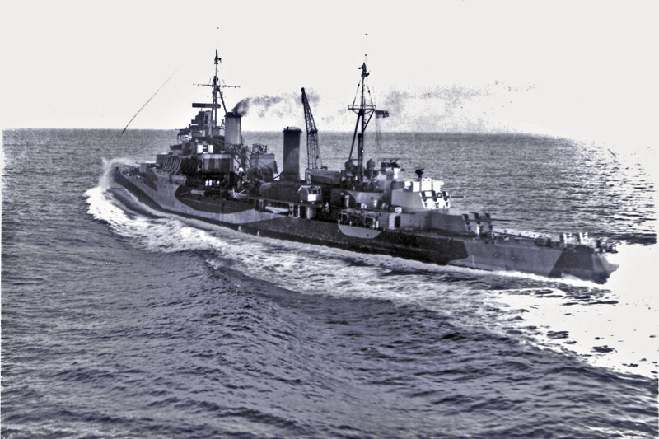
The Far East
Escort, bombardment & anti-air
Most remaining Towns in refit at end of conflict & few see theatre
Surviving Fiji units see action, along with Swiftsure –latter quickly regarded most efficient AA vessel in region. At close of conflict, Nigeria, Gambia, Bermuda, Newfoundland, Ceylon, Swiftsure & Ontario all with East Indies and Pacific Fleets
Cruisers rarely direct targets for bombing or kamikaze but potential target of opportunity & typically provided escort / protection to carriers from aerial or surface forces while transiting or conducting raids

Slide 35
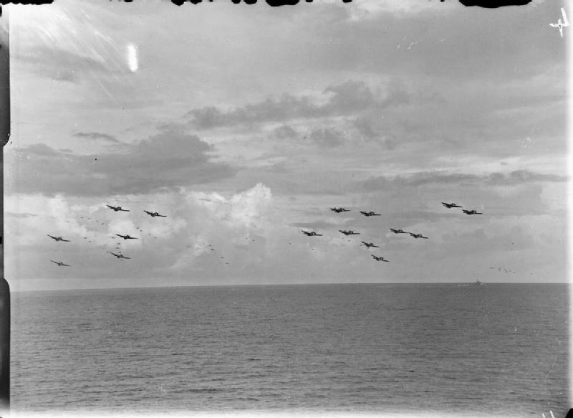
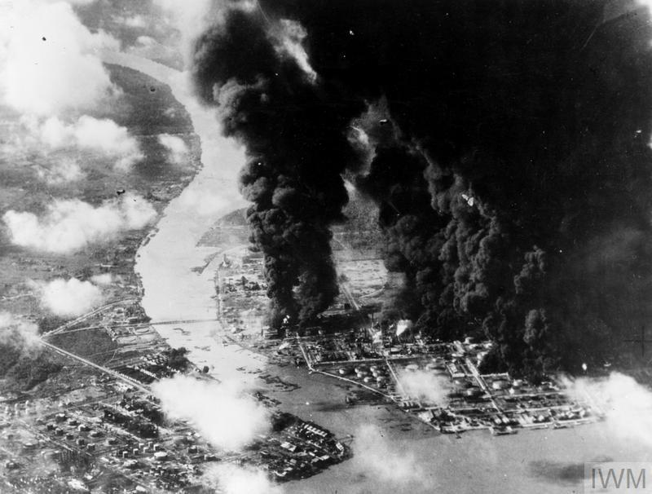
Operation Outflank
Series carrier raids on oil installations on Sumatra aiming to cripple supplies Japanese forces
Operation Robson 20 December 1944 on refineries Pankalan Brandan. HMS Newcastle part of escort
Operation Lentil 4 January 1945 repeat of attack, HMS Ceylon part of escort to carriers
Operation Meridian 24 January ‘45 (Meridian I) & 29 January ‘45 (Meridian II) on Palembang refineries (largest in SE Asia). Supported by HMS Ceylon as escort for refuelling Force 69

Slide 36
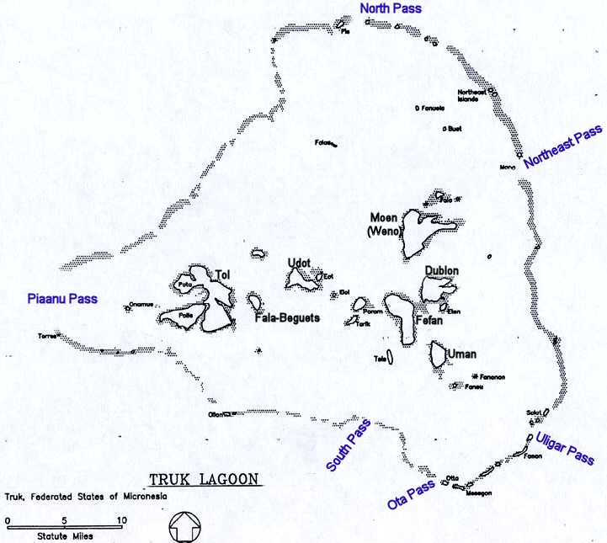
Operation Inmate
Attack British Pacific fleet Task force 111.2 on Japanese installations, Truk Atol, 14-15 June 1945
Designed as means of gaining combat experience for newly-arrived carrier Implacable & cruisers / destroyers prior to intended July invasion of Japan. In effect live-fire training exercise
14 June aerial attack; 15 June bombardment from cruisers
Truk garrison large but no offensive capacity: 13,600 IJA & 10,600 IJN personnel with coastal artillery & AA defences; some aircraft, no warships, radar station. Badly supplied from September ’44
Cruiser force inc. Swiftsure, Newfoundland & HMCS Uganda (both of Fiji class). Newfoundland recently arrived, other cruisers worked up. Cruiser bombardment added to plan after force sailed on 12 July
Aerial attack 14 June largely ineffective (few obvious targets)

Slide 37
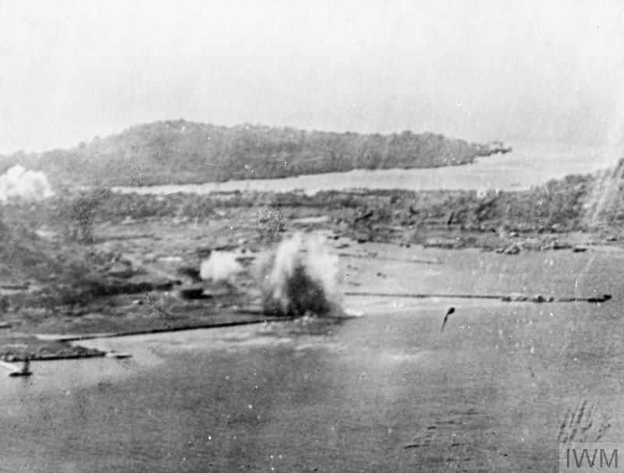
Cruiser bombardment, morning 15 June
Surface bombardment forces divided 3 task units: cruisers with destroyer, leaving 2 of latter to protect carriers
Newfoundland bombarded coastal batteries without reply; followed by successful bombardment airstrip Etan island
Achilles (yes, that one) & Uganda attempt unsuccessful bombardment seaplane base Dublon island (communication issue spotting Seafires)
Swiftsure attempts bombardment positions on Moen; fire control table malfunctions (split pin shaken loose). Attempted shift to local control ineffective as unable see targets
Bombardment ends 1110 & cruisers re-join carriers.
Damage to garrison modest –British estimate 2 aircraft destroyed, damage to airfields, oil tanks, floating dry docks, ships & dockside installations. Japanese later stated almost no damage. Truth somewhere in between. Assessed as achieving primary goal of training for forces involved.

Slide 38
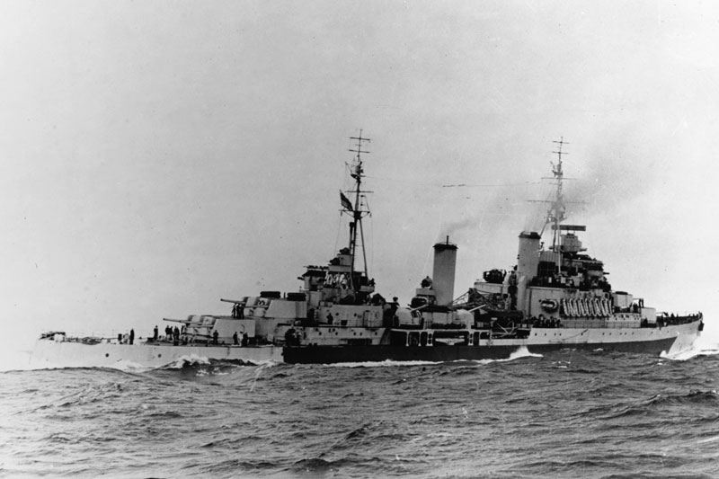
HMS Gambia
Gambia one of busiest of class in Far East. February ‘44 searching for blockade runners in Cocos Islands region
Participates in 2nd bombardment of Kamaishi 9 August with HMS Newfoundland
Allied vessels open fire on ironworks & docks from 12:54, for approx. 2hrs; average range 14,000yds. 4 passes made; 733 6in shells fired; effective & large quantities pig iron destroyed, along with 1,471 nearby houses. Gambia fired final shots when attacked kamikaze

Slide 39
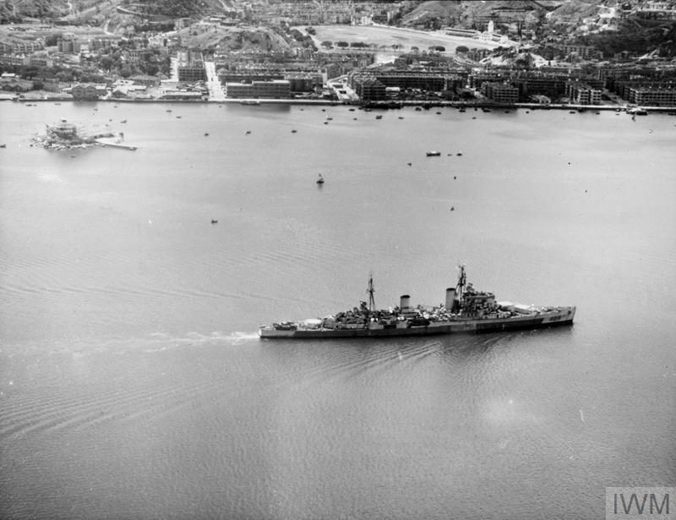
Surrender –Hong Kong
Minotaur class HMS Swiftsure selected as flag of British Pacific Cruiser Squadron by
Admiral Cecil Harcourt.
Shown above entering Victoria Harbour (Hong Kong) through North Point 30 August 1945 to accept Japanese Army garrison surrender & revert to prior status as Crown Colony.

Slide 40
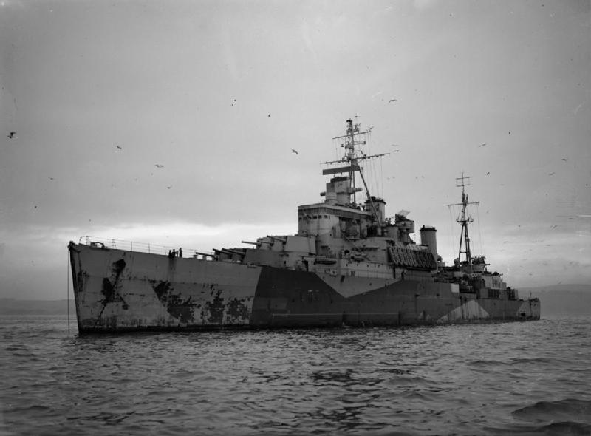
Japanese Instrument of Surrender
-Tokyo Bay, 2 September 1945
HMS Newfoundland (Batch 2 Fiji class) present Tokyo Bay 2 September 1945 for signing of Instrument of Surrender, ending World War II. Largest RN vessel present after battleships HMS King George V, HMS Duke of York & escort carriers HMS Ruler & HMS Speaker

Slide 41
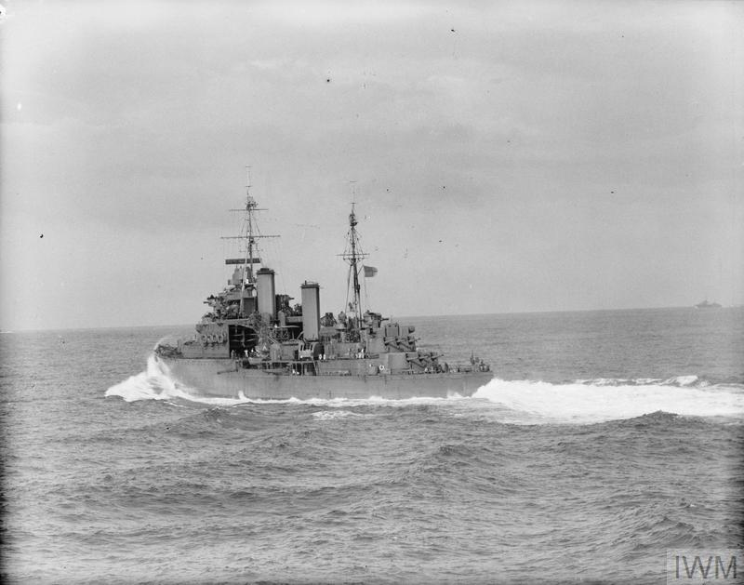
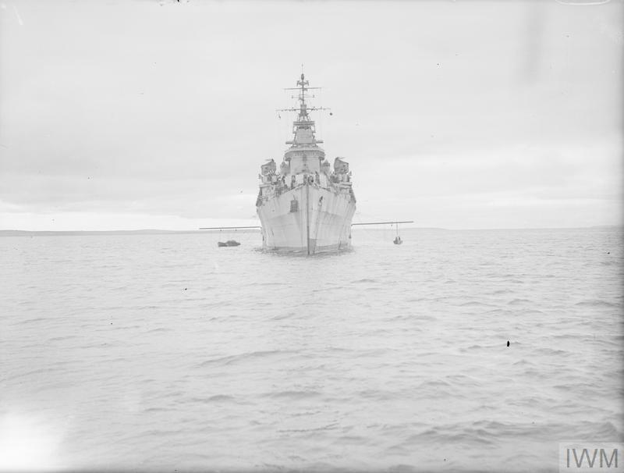
Conclusions
The Town, Fiji & Minotaur classes largely result of treaty & budgetary issues rather than purely military
Town class in effect heavy cruisers [‘30s equivalent of previous County class] with a large 6in battery rather than 8in to circumvent London Treaty restrictions on heavy cruiser construction. Reduced Fiji & Minotaurs ‘30s-’40s equivalents in turn to ‘20s York class.
Sacrifice in Towns & 1st batch Fiji’s about 34% of broadside weight. However, higher nominal rate of fire & wartime results suggests 6in was at least adequate; tactic of using these ‘large light cruisers’ with high rate 6in fire to handle smaller attackers & earlier heavier-gunned vessels for countering larger vessels sound, although crossover inevitable.
Towns size allowed for equipment growth. Reduced Fiji & Minotaurs on edge like all reduced vessels at time of design & more limited in growth potential but performed well
In combat, vessels proved effective designs. Fijis in particular saw little surface combat but performed well suggesting balance of speed / armament / protection well-judged. Good anti-air platforms. Vulnerable to underwater weapons however & machinery large / weighty compared to rivals
Vessels gave good service in all theatres & roles, often with little drama but performing workhorse duties

